Slide 1

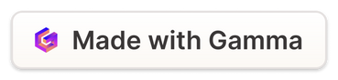
Advanced MongoDB
This presentation will cover advanced MongoDB concepts, including Aggregation, Regex, Embedded Documents, and Cursors. These techniques are essential for efficiently managing and manipulating data within a MongoDB database.
by Harsh Ghorecha
HG
Notes:
1

Slide 2
INPUT
$match
$group
$sort
OUTPUT
Aggregation
1
Data Transformation
2
Group & Summarize
3
Powerful Features
Aggregation pipelines allow you to process data in a structured manner, transforming and summarizing data based on specific criteria.
Aggregation operations such as $group and $match allow you to group documents and calculate aggregate statistics, enabling you to gain valuable insights from your data.
MongoDB's Aggregation Framework offers a rich set of operators and functionalities for advanced data analysis and reporting.
Notes:
2

Slide 3
Overview of the Aggregation Pipeline
Example:-
1
Stage 1: $match
db.emp.aggregate([
{"$group":{_id:"$Dept", qty:{$sum:1}}},
{$match: { qty: {$gt: 1} } }])
This stage filters documents based on a given condition, allowing you to select specific data for further processing.
2
Stage 2: $group
This stage groups documents based on a specified key, aggregating values and summarizing data within each group.
db.emp.aggregate([
{$match: { Dept: "CE" } },
{$group:{_id:"$Dept", count: {$sum: 1}}
} ])
3
Stage 3: $project
This stage transforms the documents, selecting specific fields and creating new ones based on data transformations.
Notes:
3

Slide 4
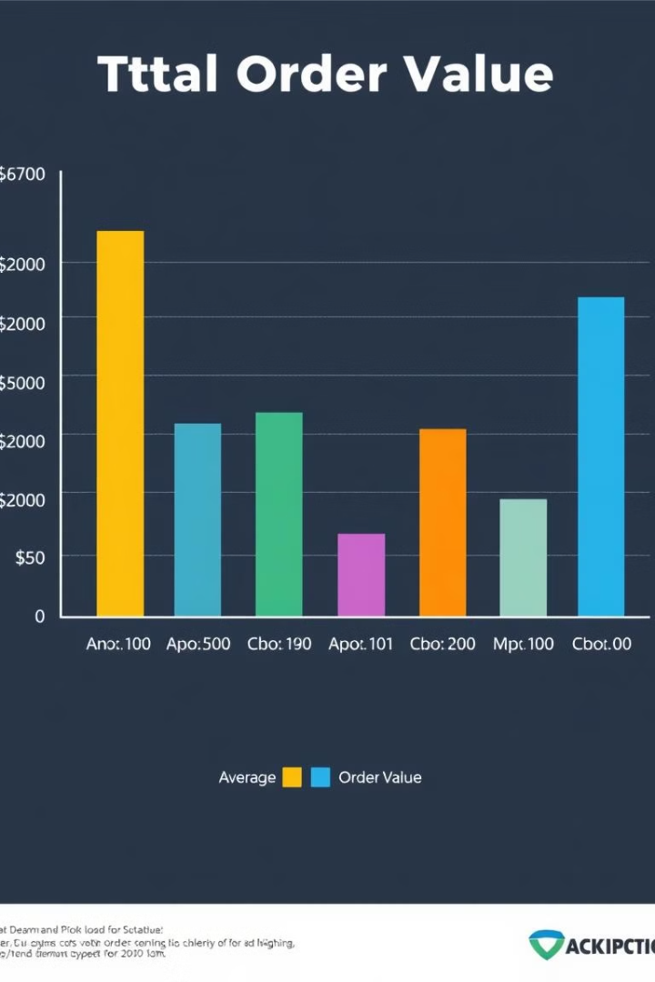
Example: Calculating Average Order Value
Stage
Description
$match
Selects documents related to orders placed within a specified date range.
$group
Groups documents by customer ID and calculates the total order value for each customer.
$project
Creates a new document containing the customer ID and the average order value.
Notes:
4

Slide 5

Regex
Pattern Matching
Data Validation
Text Processing
Regex, or Regular Expressions, allows you to search for specific patterns within strings, making it ideal for tasks like data validation and text processing.
Use Regex to ensure that data conforms to specific formats, such as email addresses, phone numbers, or date formats.
Extract specific information from unstructured text data, such as names, addresses, or keywords.
Notes:
5

Slide 6
Using Regular Expressions for Querying
Syntax
Example
Benefits
Use the $regex operator in your MongoDB queries to match documents based on specific patterns.
db.users.find({ "email": { $regex: "@example\.com" } })
Regex provides a powerful and flexible way to search for data based on complex patterns, making data retrieval more efficient and precise.
Notes:
6

Slide 7
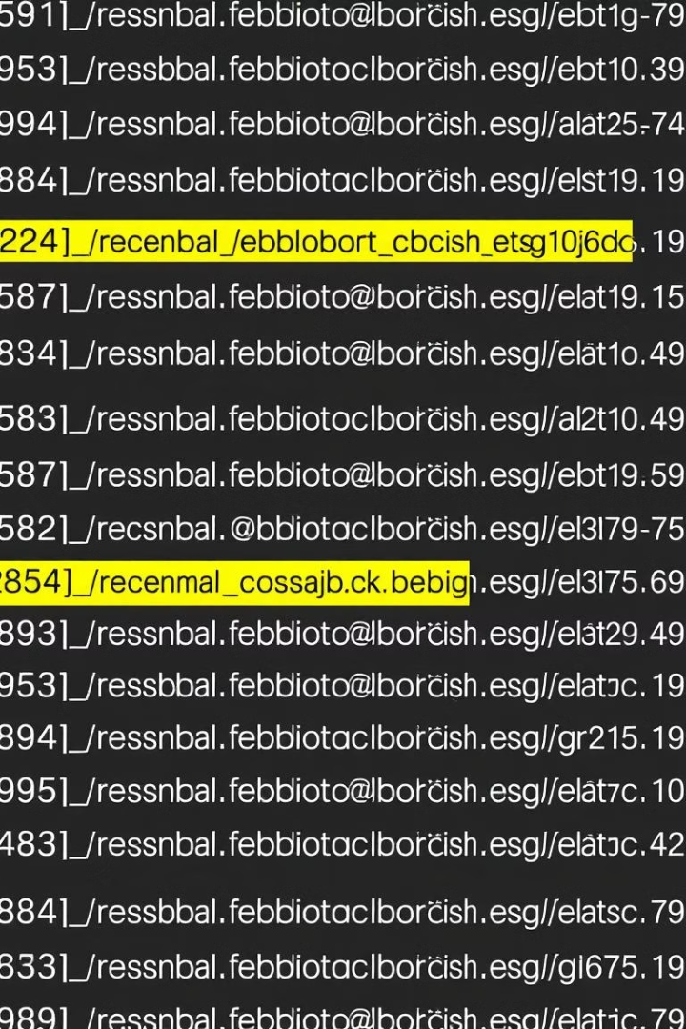

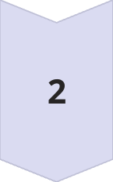

Example: Searching for Email Addresses
Goal
Find all users whose email addresses belong to the "example.com" domain.
Query
db.users.find({ "email": { $regex: "@example\.com" } })
Result
The query will return a list of users whose email addresses match the specified pattern.
Notes:
7

Slide 8
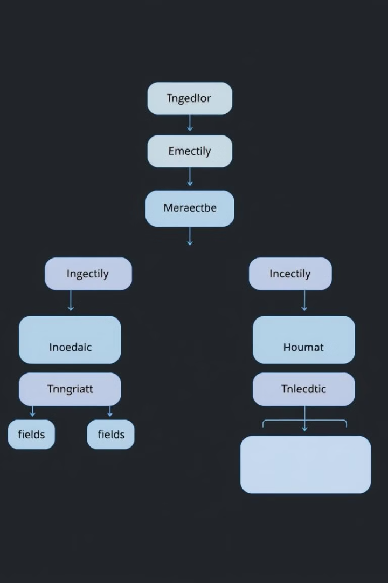



Embedded Documents
Data Organization
Embed related data within a single document to avoid unnecessary joins and improve data retrieval efficiency.
Relationships
Model one-to-one and one-to-many relationships between entities by embedding related data within a single document.
Performance
By embedding related data, you reduce the number of queries required to access related information, leading to faster retrieval times.
Notes:
8

Slide 9
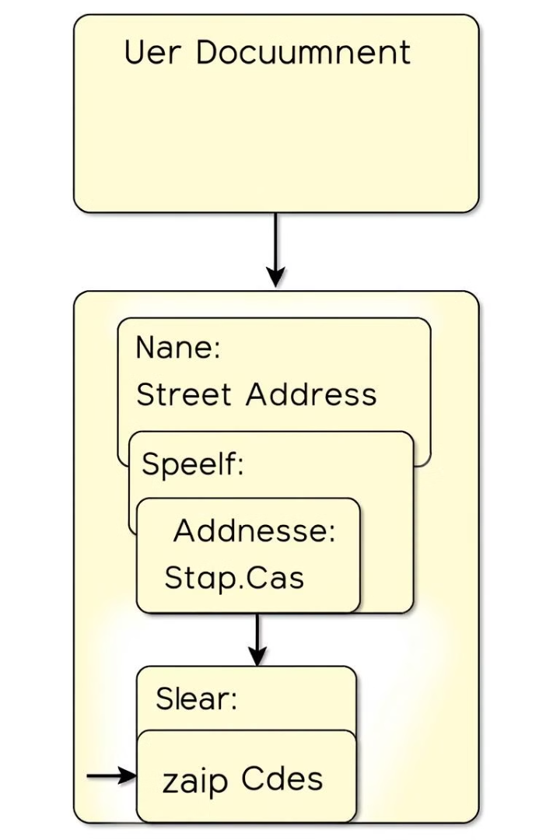
Modeling Data with Embedded Documents
1
User Document
2
Address Details
The main document represents a user with fields like username, email, and other basic information.
An embedded document within the user document stores the user's address information, including street, city, state, and zip code.
Notes:
9

Slide 10
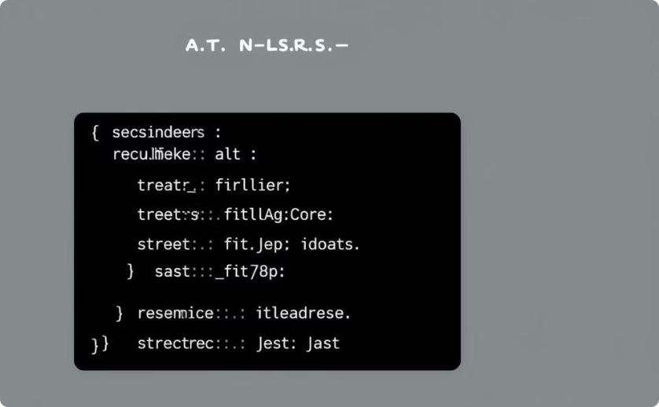
Example: Storing User Profiles with Nested Address
{
"_id": ObjectId("unique_user_id"),
"name": "John Doe",
"email": "john.doe@example.com",
"age": 30,
"address": {
"street": "123 Main St",
"city": "New York",
"state": "NY",
"zipcode": "10001"
}
}
Nested Document :
address is a nested Document of Employees Document
Document Structure
Querying
The user document contains nested fields for address information.
To retrieve the user's address, access the nested fields within the user document using dot notation.
Notes:
10

